Slide 1
Library System
Professor: Rujuan Xing
Students: Gustavo Sousa
Diego Lussich

Slide 2
Presentation:
System functionalities
Class Diagram
Sequence Diagrams
Comments about the solution
Answer questions

Slide 3
System functionalities:
Mandatory use cases
Login a user
Add a new library member to the system
Checkout a book for a library member
Add a copy of an existing book to the library collection
Optional use cases
Given a library member id, print the checkout record of that library member

Slide 4
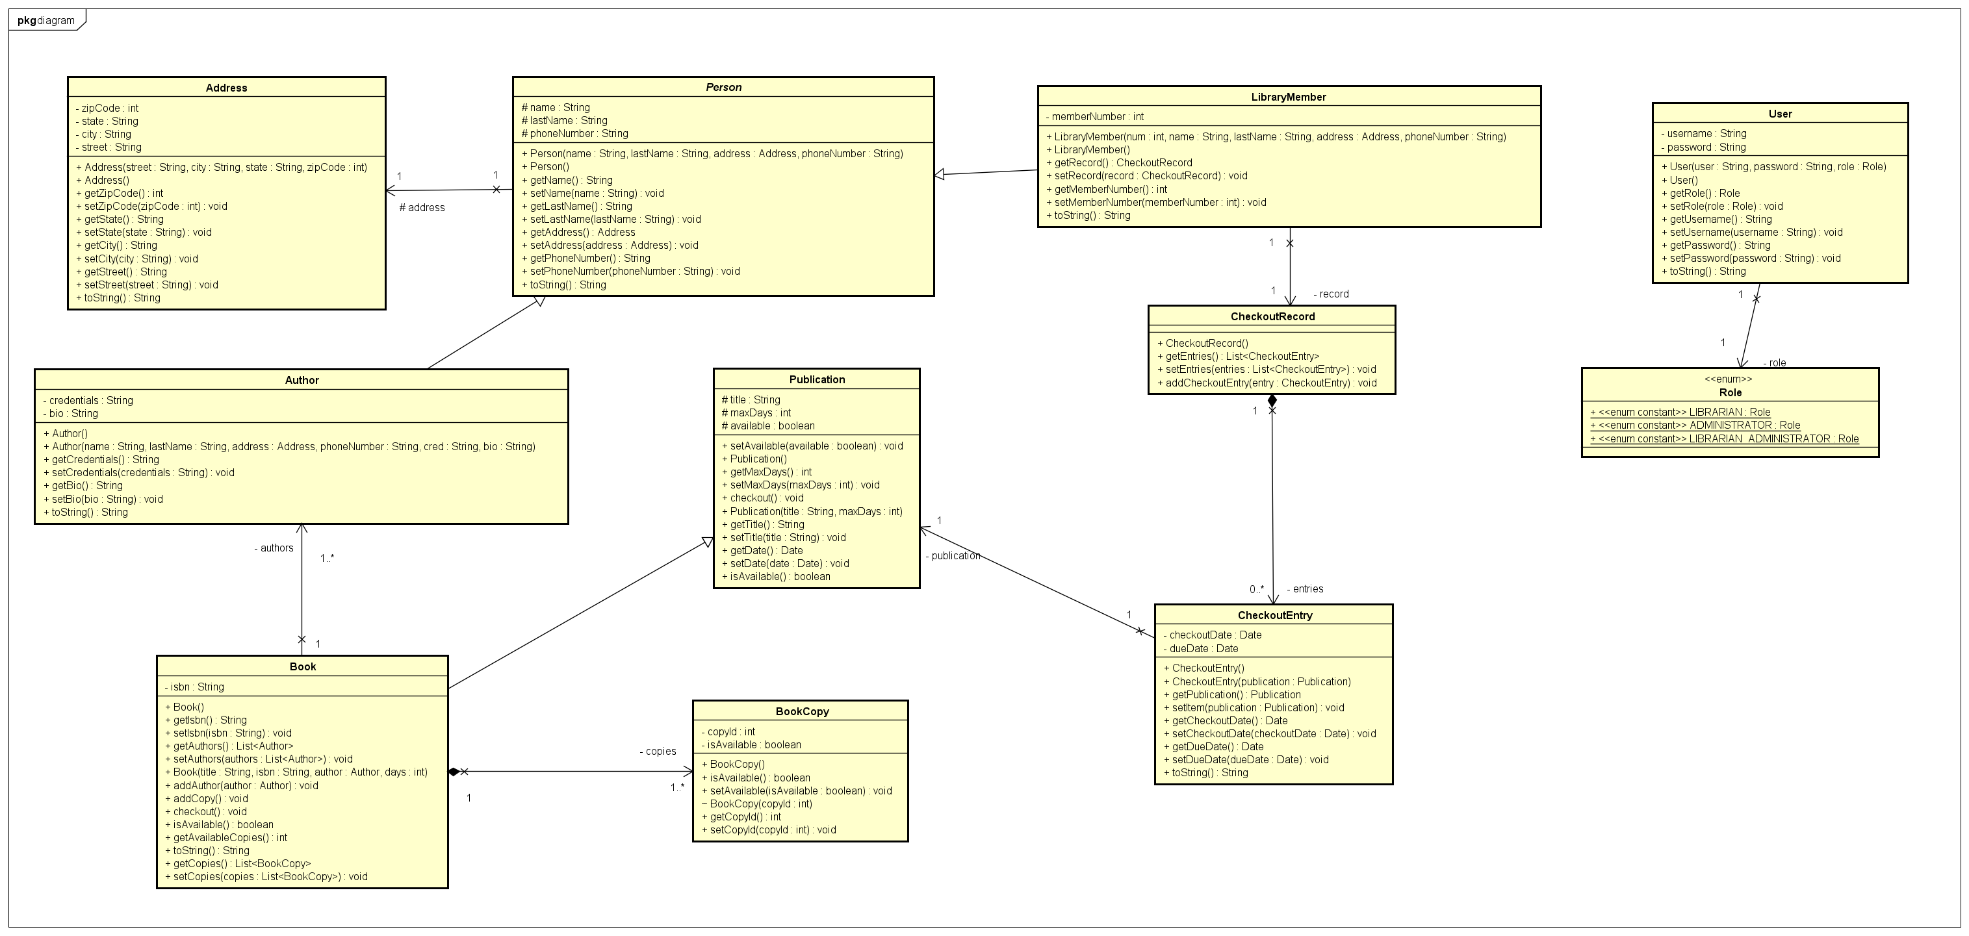
Class Diagram:

Slide 5
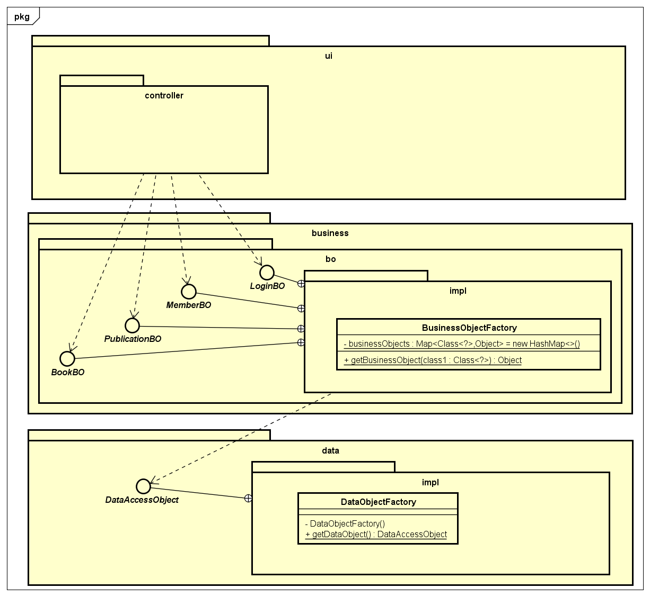
Class Diagram:

Slide 6
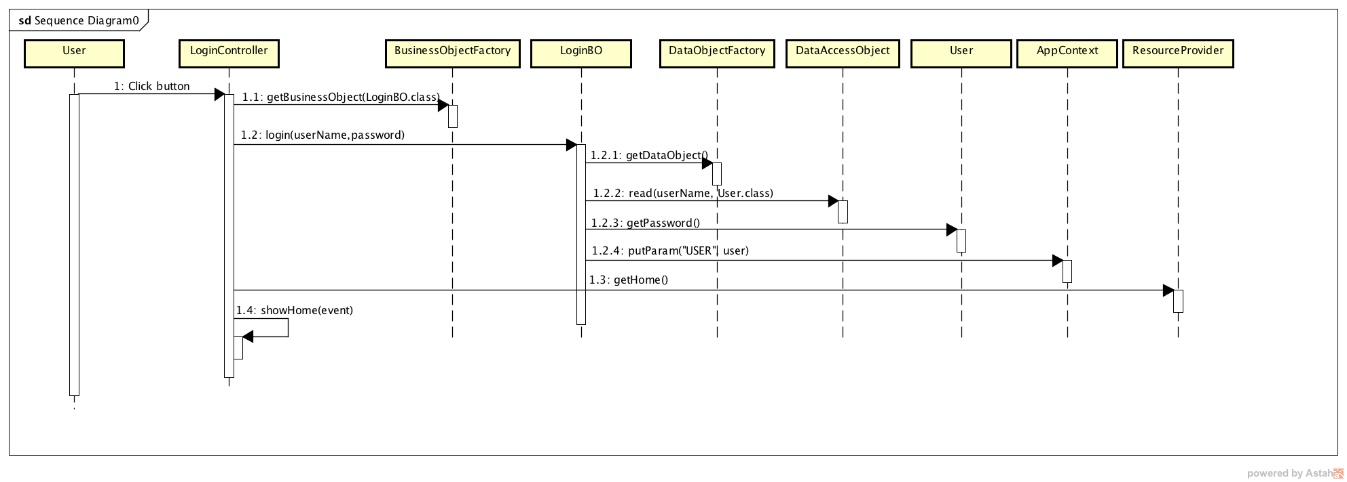
Sequence Diagrams:

Slide 7
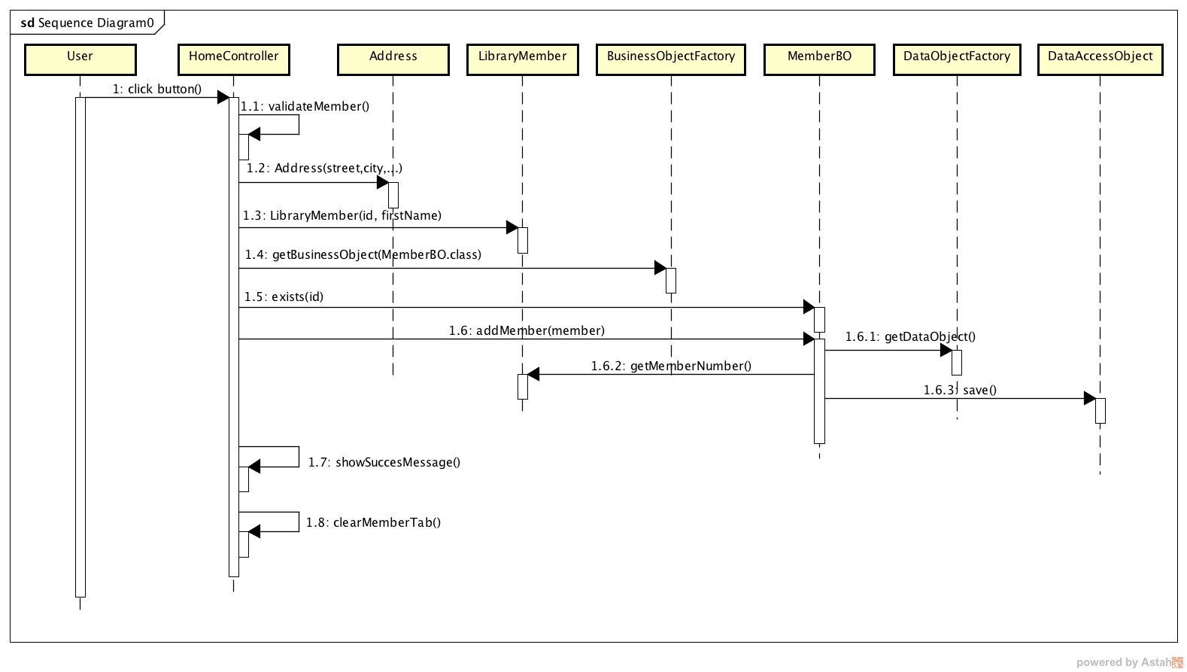
Sequence Diagrams:

Slide 8
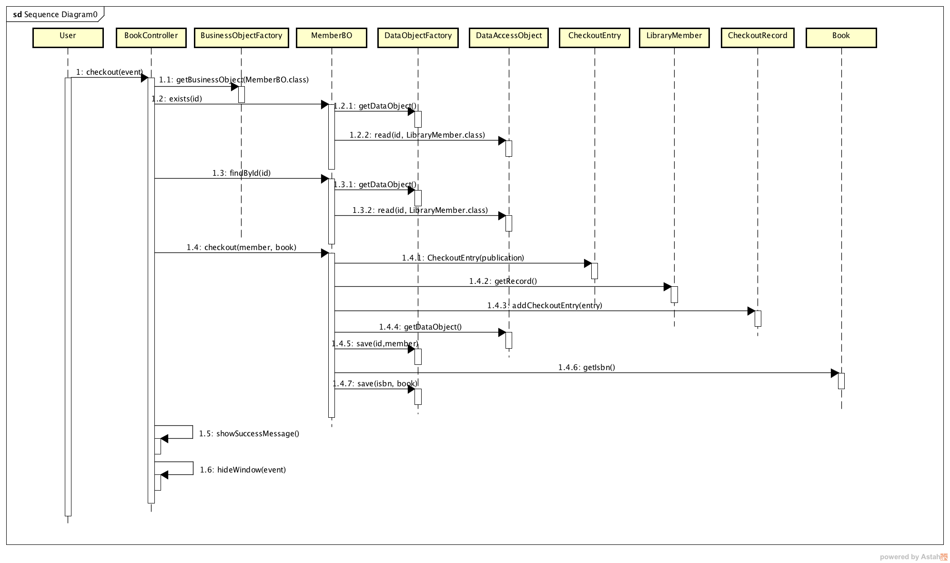
Sequence Diagrams:

Slide 9
Comments about the solution:
Layer based architecture
Delegation
Dependency injection
JSon serialization

Slide 10
Answer questions:
?

Slide 11
Thank you

